Slide 1
Applied Data Science L2. Learning from Data. Cross-validation. Data pre-processing
Irina Mohorianu
Head of Bioinformatics/ Scientific Computing @CSCI

Slide 2
We’ve got data. Find the signal! Data (pre-processing)
Finding patterns in the data
i.e. the technical characteristics of the data are less important than the pattern (model)
Input: some data
Methods: statistical analysis, machine learning, programming
Output: a robust, reproducible, generalizable model
Input
Pre-processing
ML model
[1] Accuracy – how well does the data reflect a real object/ event
[2] Completeness – are all mandatory/ necessary features present?
[3] Consistency – repeated entries/ consistent labels?
[4] Invariance in time – is the data outdated or a mix of old & new?
[5] Believability – the presented values are trustworthy
[6] Interpretability – the data and conclusions can be interpreted
Parametric/
non-parametric
Can handle continuous/
categorical vars?
Raw data

Slide 3
Data (pre-processing). Feature engineering Overview of concepts.
Input
Pre-processing
ML model
[1] Accuracy
[2] Completeness
[3] Consistency
[4] Invariance in time
[5] Believability
[6] Interpretability
[a] Understanding the structure of the data
type of features: continuous, categorical
ranges of features: [min, max], number of categories
missing information [labels, features]
discriminative power of features (redundancy)
[b] Adjusting data without tampering with signal
Expression ranges and One-hot encoding
Standardisation vs scaling
Near zero variance
Multi-collinearity
Dimensionality reduction
[c] creating robust models – cross-validation. Bias/ variance
Training/ Validation/ Test splitting
Cross-validation
Parametric/
non-parametric
Can handle continuous/
categorical vars?
Feature selection
Raw data

Slide 4
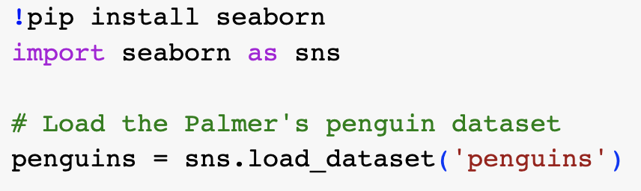
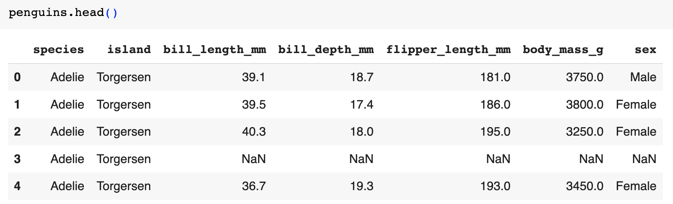
Data pre-processing. Feature engineering Understanding the structure of the data
[a] Understanding the structure of the data
type of features: continuous, categorical
ranges of features: [min, max], number of categories
missing information [labels, features]
discriminative power of features (redundancy)
Continuous features
Categorical features
Missing data
Horst AM, Hill AP, Gorman KB (2020). palmerpenguins: Palmer
Archipelago (Antarctica) penguin data. R package version 0.1.0.
https://allisonhorst.github.io/palmerpenguins/. doi:10.5281/zenodo.3960218.

Slide 5
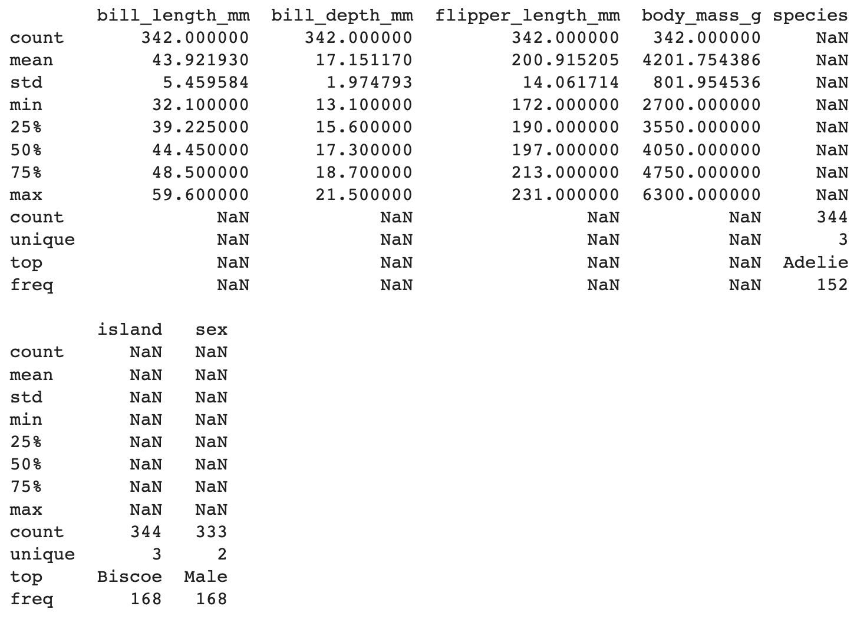
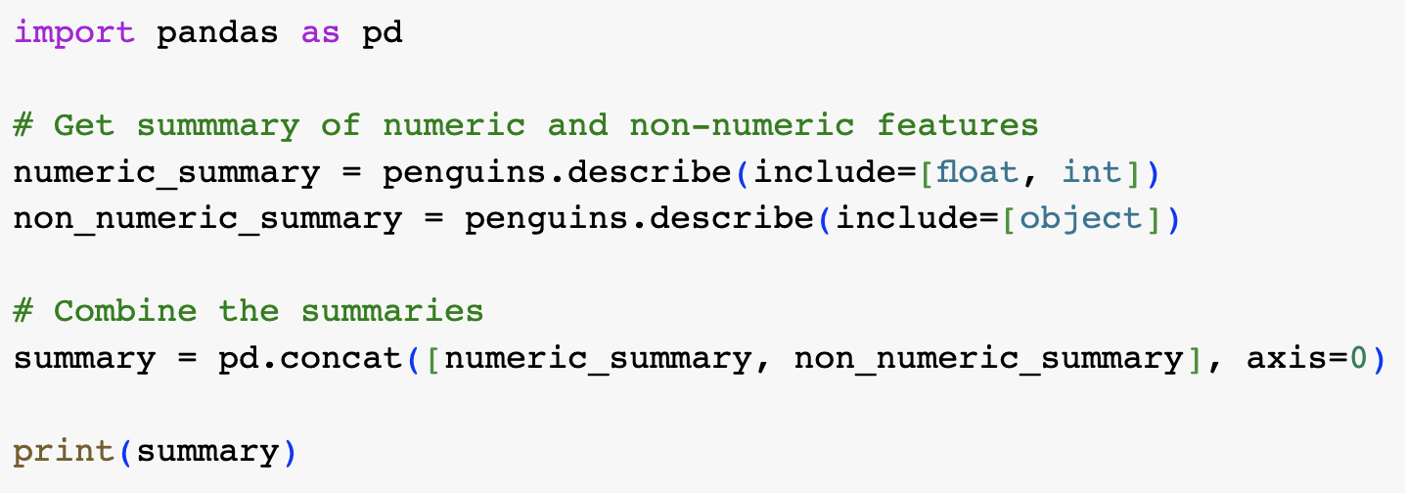
Data pre-processing. Feature engineering Understanding the structure of the data
Knowing your dataset is essential – explore, clean, visualize (part of) your data
Examine several rows of data
Check basic statistics. Evaluate data types
Assess missing entries

Slide 6
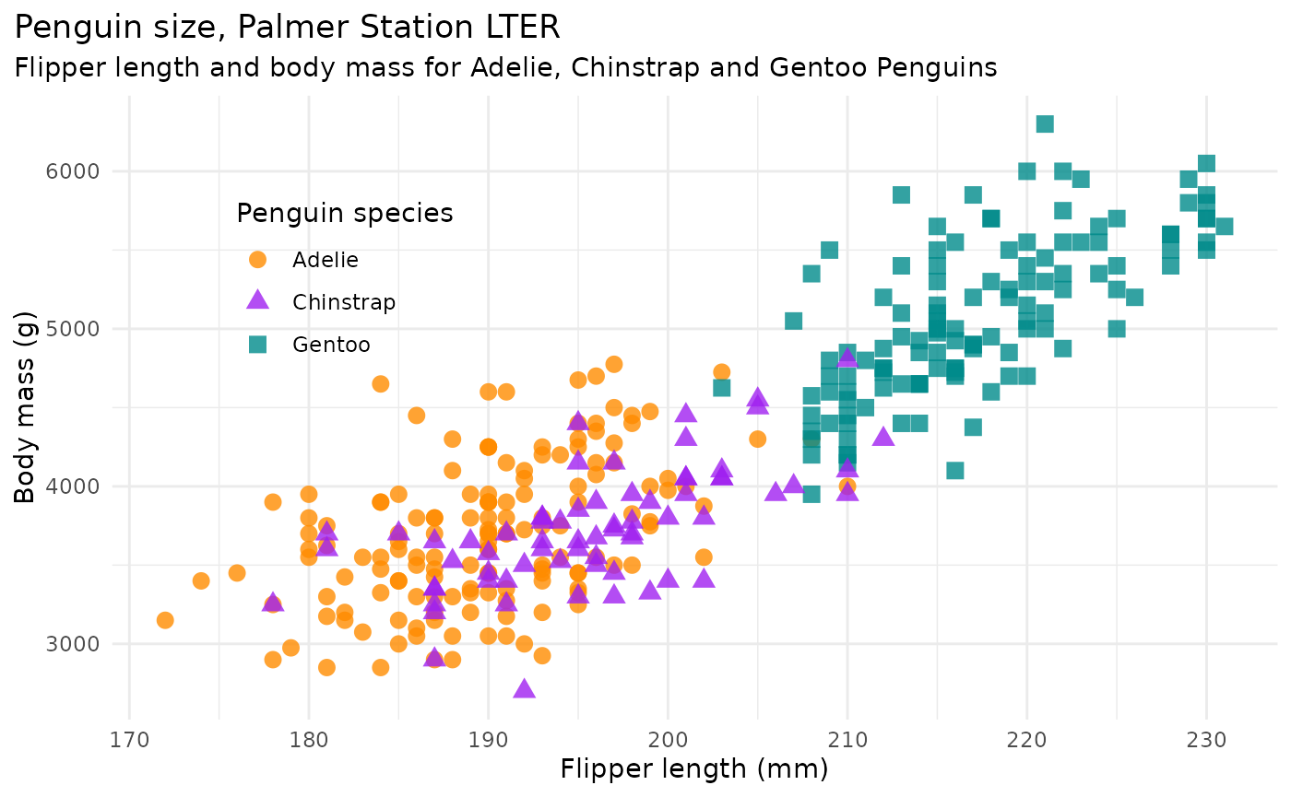
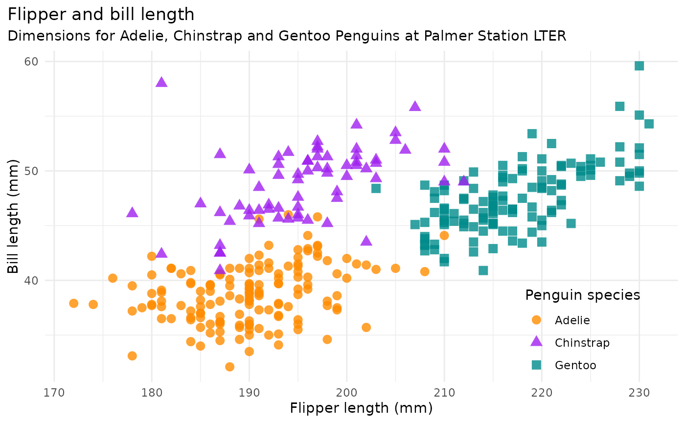
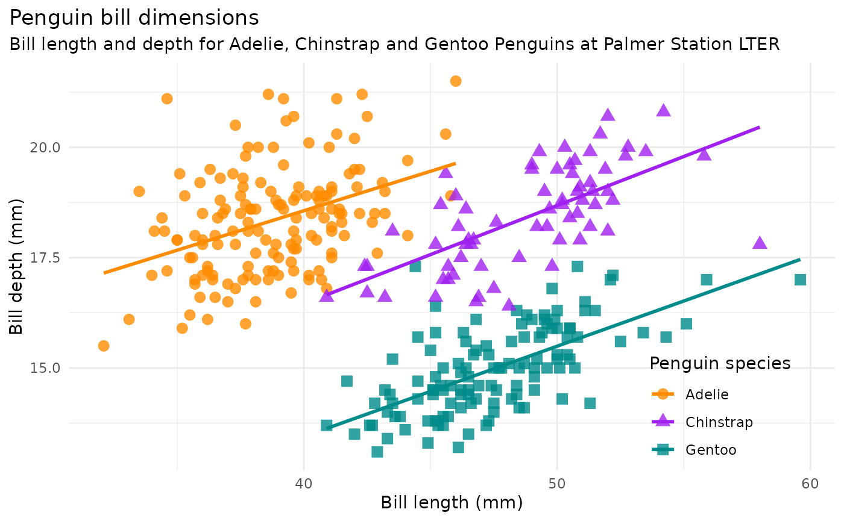
Data pre-processing. Feature engineering Understanding the structure of the data
The body mass is highly correlated to flipper length
(top left)
We note linear separability between classes
The colinearity differs per class (bottom left).

Slide 7
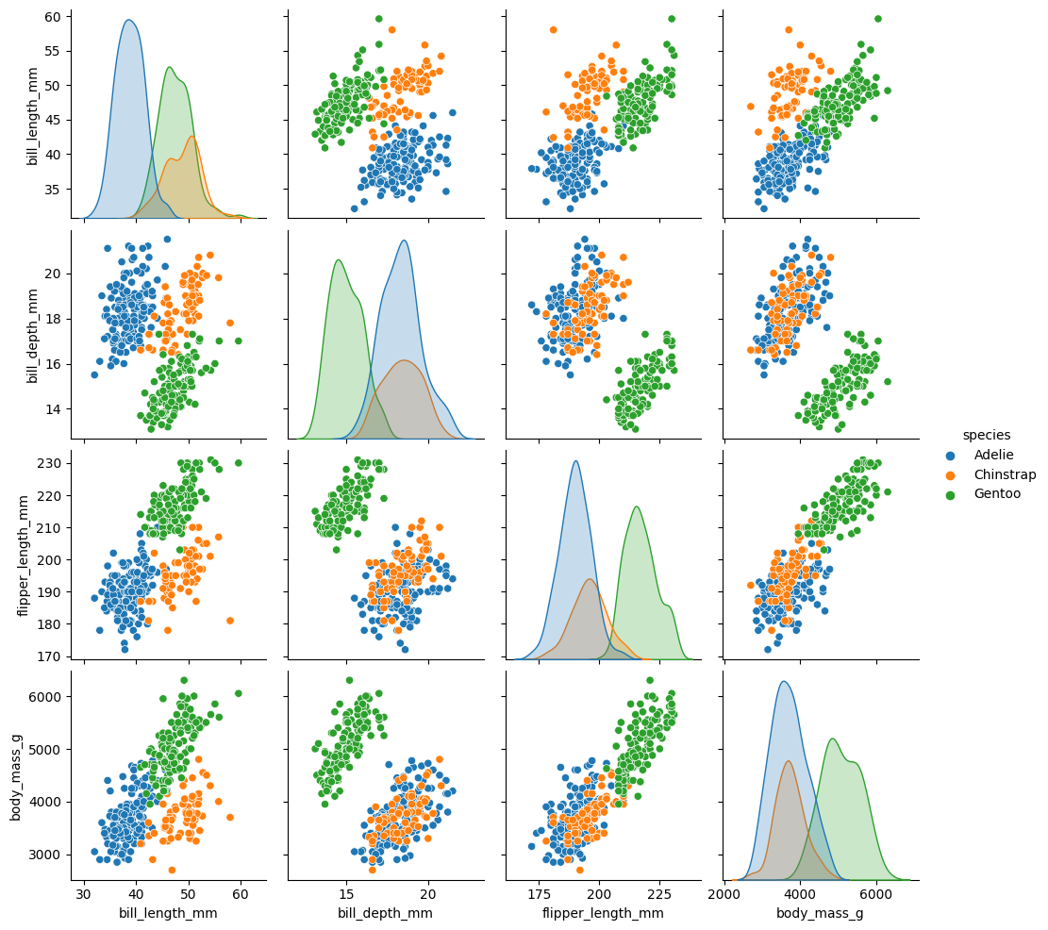
Data pre-processing. Feature engineering Understanding the structure of the data

Slide 8
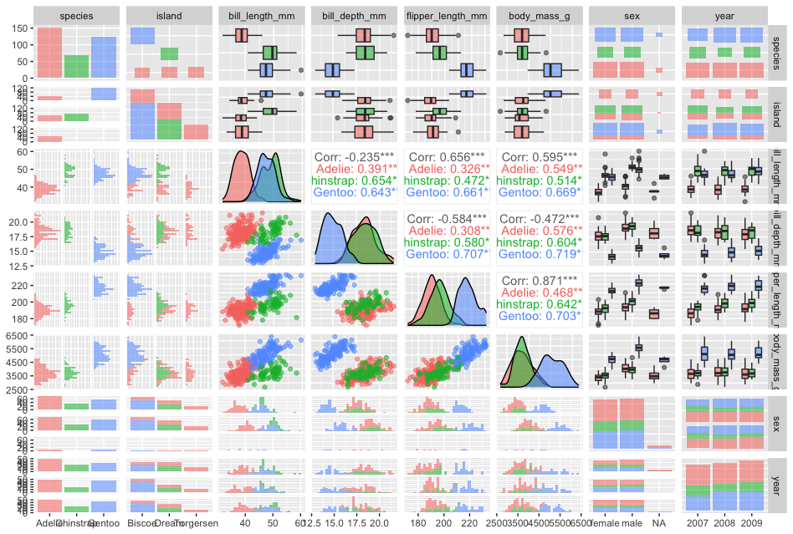
Data pre-processing. Feature engineering Understanding the structure of the data
ggpairs(penguins, ggplot2::aes(colour = species, alpha = 0.4))
Simpson's paradox is observed in probability and statistics; a trend appears in several groups of data but disappears or reverses when the groups are combined.

Slide 9
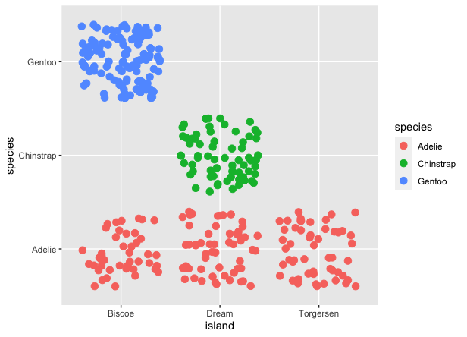
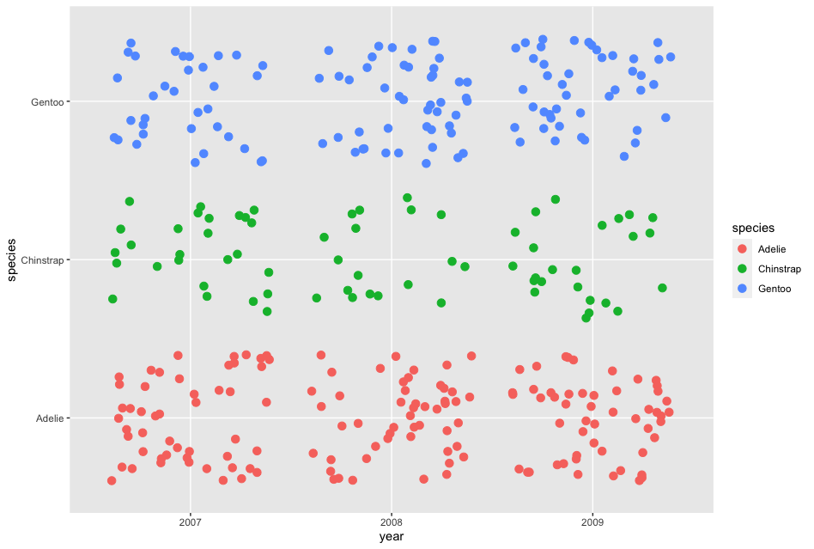
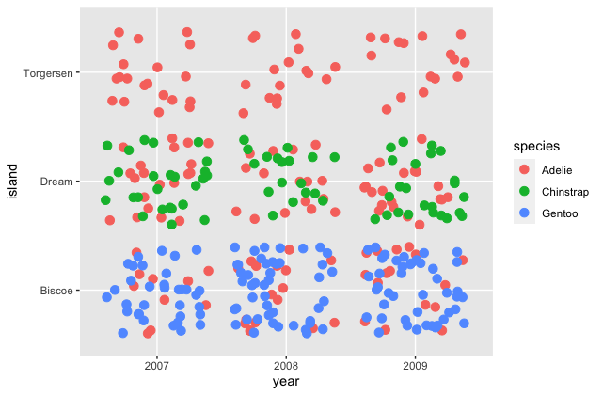
Data pre-processing. Feature engineering Understanding the structure of the data
table(penguins$species, penguins$island)
Biscoe Dream Torgersen
Adelie 44 56 52
Chinstrap 0 68 0
Gentoo 124 0 0

Slide 10
Data pre-processing. Feature engineering Adjusting data without tampering with signal
Adjusting data without tampering with signal
Expression ranges and One-hot encoding
Standardisation vs scaling
Near zero variance
Multi-collinearity
Dimensionality reduction
summary(penguins)
species island bill_length_mm bill_depth_mm
Adelie :152 Biscoe :168 Min. :32.10 Min. :13.10
Chinstrap: 68 Dream :124 1st Qu.:39.23 1st Qu.:15.60
Gentoo :124 Torgersen: 52 Median :44.45 Median :17.30
Mean :43.92 Mean :17.15
3rd Qu.:48.50 3rd Qu.:18.70
Max. :59.60 Max. :21.50
NA's :2 NA's :2
flipper_length_mm body_mass_g sex year
Min. :172.0 Min. :2700 female:165 Min. :2007
1st Qu.:190.0 1st Qu.:3550 male :168 1st Qu.:2007
Median :197.0 Median :4050 NA's : 11 Median :2008
Mean :200.9 Mean :4202 Mean :2008
3rd Qu.:213.0 3rd Qu.:4750 3rd Qu.:2009
Max. :231.0 Max. :6300 Max. :2009
NA's :2 NA's :2
Continuous features: bill length, depth, flipper length, body mass
Categorical features: island, sex, year
Output: species (categorical i.e. classification problem)

Slide 11
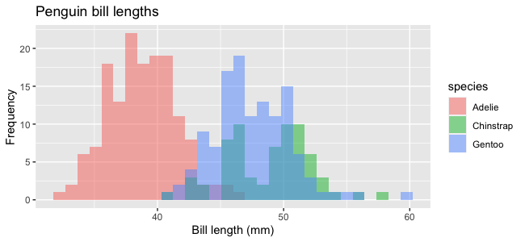
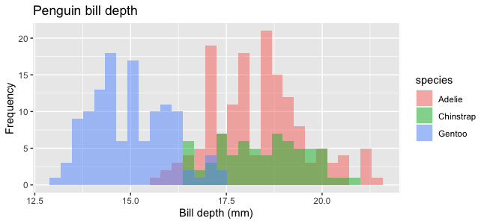
Data pre-processing. Feature engineering Adjusting data without tampering with signal
Adjusting data without tampering with signal
Expression ranges and One-hot encoding
Standardisation vs scaling
Near zero variance
Multi-collinearity
Dimensionality reduction
bill_length_mm bill_depth_mm flipper_length_mm body_mass_g
Min. :32.10 Min. :13.10 Min. :172.0 Min. :2700
1st Qu.:39.23 1st Qu.:15.60 1st Qu.:190.0 1st Qu.:3550
Median :44.45 Median :17.30 Median :197.0 Median :4050
Mean :43.92 Mean :17.15 Mean :200.9 Mean :4202
3rd Qu.:48.50 3rd Qu.:18.70 3rd Qu.:213.0 3rd Qu.:4750
Max. :59.60 Max. :21.50 Max. :231.0 Max. :6300
NA's :2 NA's :2 NA's :2 NA's :2
The ranges are not comparable.
Standardization vs scaling
[min, max] scaling to a predefined range
Robust scaling – the transformation is performed on the IQR
Z transformation (on mean, standard deviation or median and MAD)

Slide 12
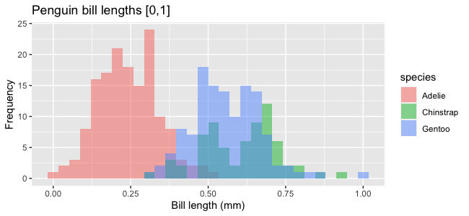
Data pre-processing. Feature engineering Adjusting data without tampering with signal
Adjusting data without tampering with signal
Expression ranges and One-hot encoding
Standardisation vs scaling
Near zero variance
Multi-collinearity
Dimensionality reduction
[min, max] scaling to a predefined range
[min, max] --> [0,1]
[min, max] – min --> [min - min, max - min]
[min - min, max - min] / (max - min) --> [0,1]
[min, max] --> [0,1] --> [a,b]
Use a linear transformation f(x) = mx + n
f(0) = n => a = n
f(1) = m + n => b = m + n => m = b - a
f(x) = (b - a) * x + a

Slide 13
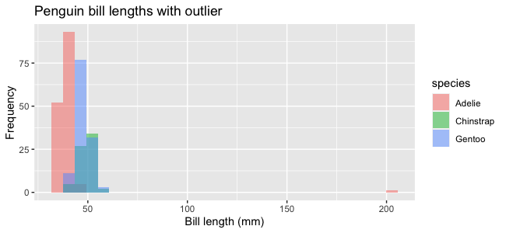
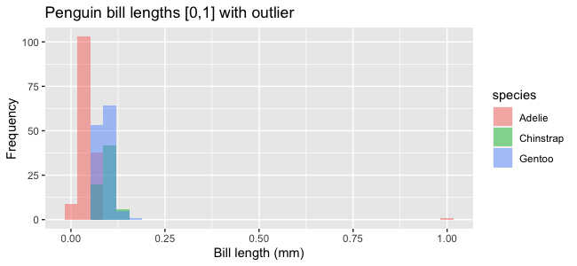
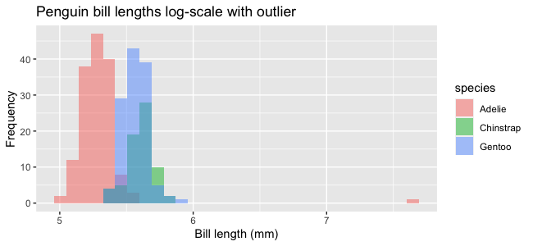
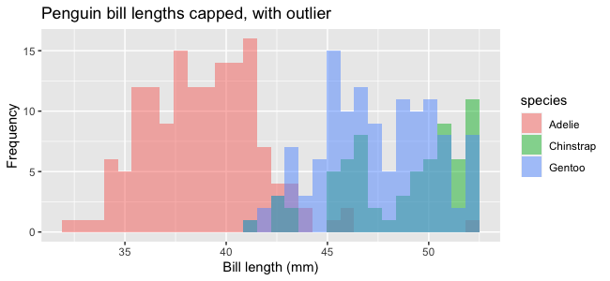
Data pre-processing. Feature engineering Adjusting data without tampering with signal
Adjusting data without tampering with signal
Expression ranges and One-hot encoding
Standardisation vs scaling
Near zero variance
Multi-collinearity
Dimensionality reduction
outlier
Outliers can skew the data and lead to misinterpretations.
The proposed scaling does not change the distribution.
Log₂ transformation of bill lengths
Capped values of bill lengths

Slide 14
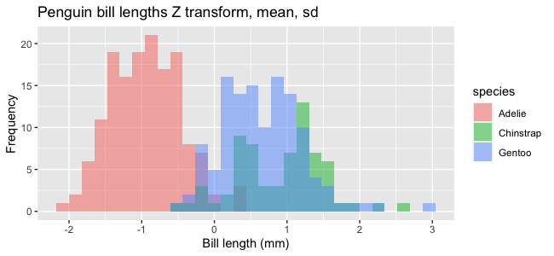
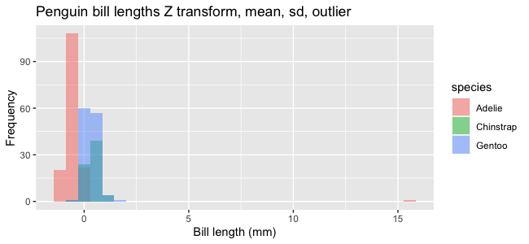
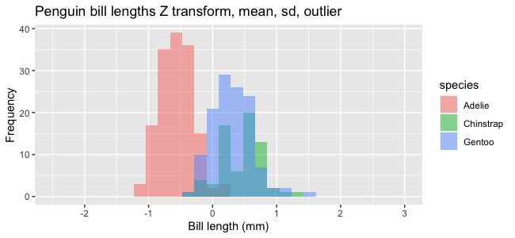
Data pre-processing. Feature engineering Adjusting data without tampering with signal
Adjusting data without tampering with signal
Expression ranges and One-hot encoding
Standardisation vs scaling
Near zero variance
Multi-collinearity
Dimensionality reduction
mean = 43.92
sd = 5.49
$$Z= \frac{x_{i}−μ}{σ}$$
mean = 44.39
sd = 10.04

Slide 15
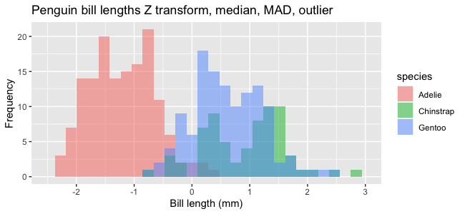
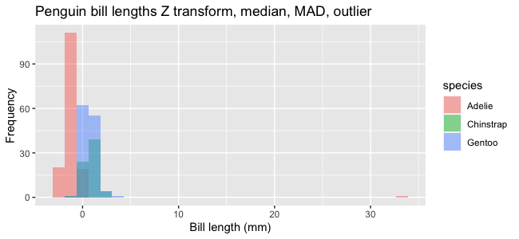
Data pre-processing. Feature engineering Adjusting data without tampering with signal
Adjusting data without tampering with signal
Expression ranges and One-hot encoding
Standardisation vs scaling
Near zero variance
Multi-collinearity
Dimensionality reduction
$$Z= \frac{x_{i}−μ}{σ}$$
Mean and sd can be influenced by outliers.
Median, MAD are more robust
MAD = median absolute deviation
mean = 43.92
sd = 5.49
mean_o = 44.39
sd_o = 10.04
median = 44.45
median_o = 44.5
MAD = 4.7
$$Z_{med}=\frac{x_{i}−median}{MAD}$$
$$MAD=median\left(\left|x_{i}−median\right|\right)$$

Slide 16
Data pre-processing. Feature engineering Adjusting data without tampering with signal
Adjusting data without tampering with signal
Expression ranges and One-hot encoding
Standardisation vs scaling
Near zero variance
Multi-collinearity
Dimensionality reduction
The island feature is difficult to handle in a numerical setting.
[longitude and latitude]
[distance from the POI]
Do we want to compare classes or use them in a static way?
species island sex year
Adelie :152 Biscoe :168 female:165 2007:110
Chinstrap: 68 Dream :124 male :168 2008:114
Gentoo :124 Torgersen: 52 NA's : 11 2009:120
Hamming (Edit) distances
Briscoe 100
Dream 010
Briscoe 100
Torgersen 001
Briscoe 1
Dream 2
Torgersen 3
Briscoe 100
Dream 010
Torgersen 001

Slide 17
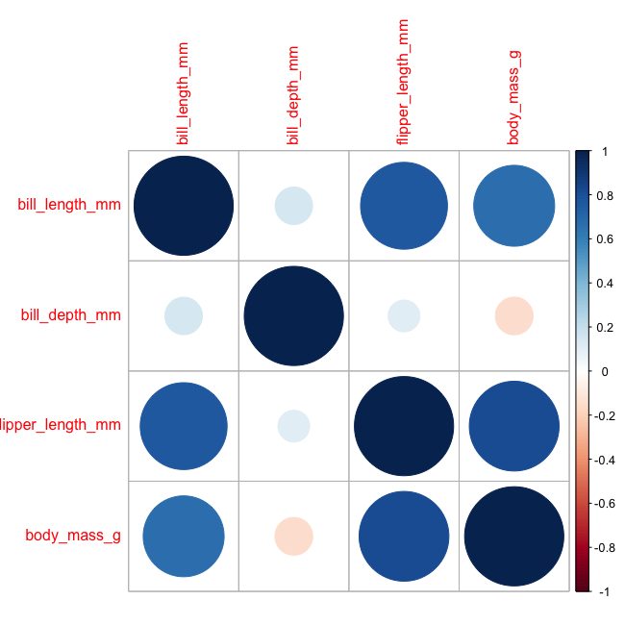
Data pre-processing. Feature engineering Adjusting data without tampering with signal
Adjusting data without tampering with signal
Expression ranges and One-hot encoding
Standardisation vs scaling
Near zero variance
Multi-collinearity
Dimensionality reduction
The near zero variance protects against constant features.
freqRatio percentUnique zeroVar nzv
species 1.226891 0.9009009 FALSE FALSE
flipper_length_mm 1.235294 16.2162162 FALSE FALSE
body_mass_g 1.200000 27.9279279 FALSE FALSE
sex.female 1.018182 0.6006006 FALSE FALSE
sex.male 1.018182 0.6006006 FALSE FALSE
There are no issues on near zero variance.
The maximum correlation is 0.76 between bill and flipper length.
Highly correlated features:
[a] could be excluded
[b] could be replaced with
a representative
a weighted summary

Slide 18
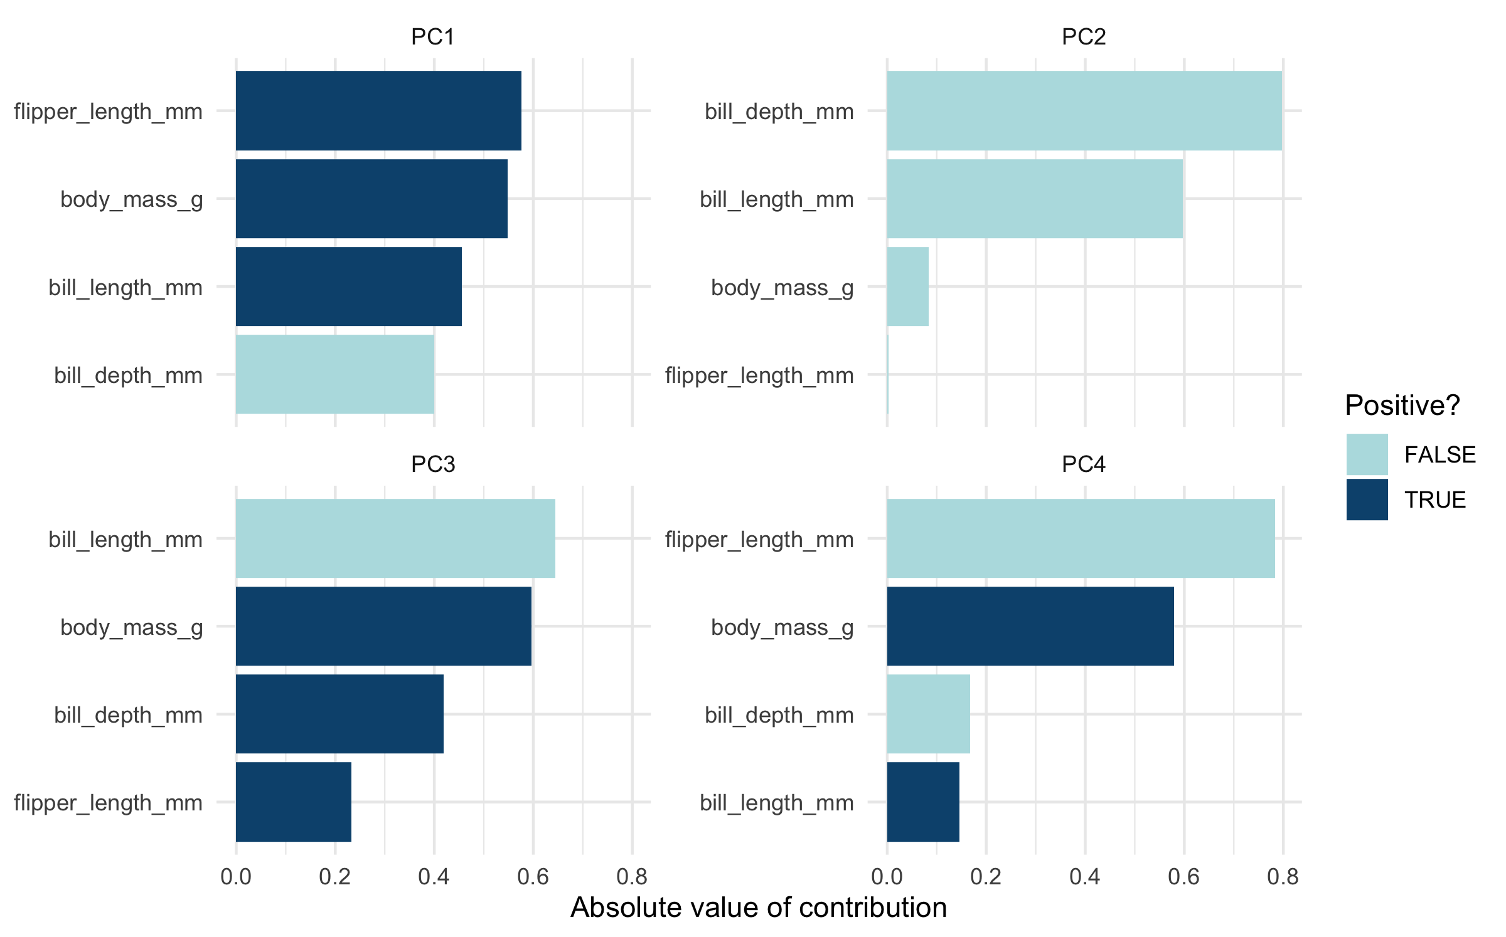
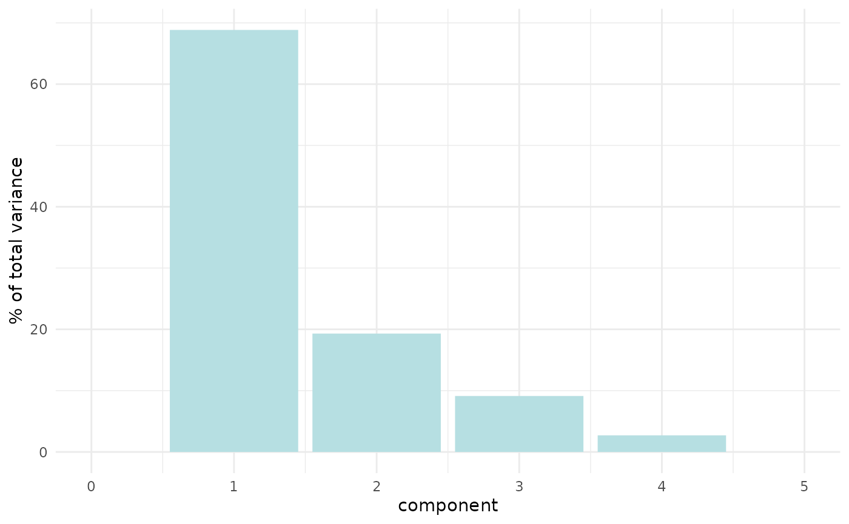
Data pre-processing. Feature engineering Adjusting data without tampering with signal
Adjusting data without tampering with signal
Expression ranges and One-hot encoding
Standardisation vs scaling
Near zero variance
Multi-collinearity
Dimensionality reduction
Yet another angle of linear combination of features is:
Principal Component Analysis (very briefly presented)

Slide 19
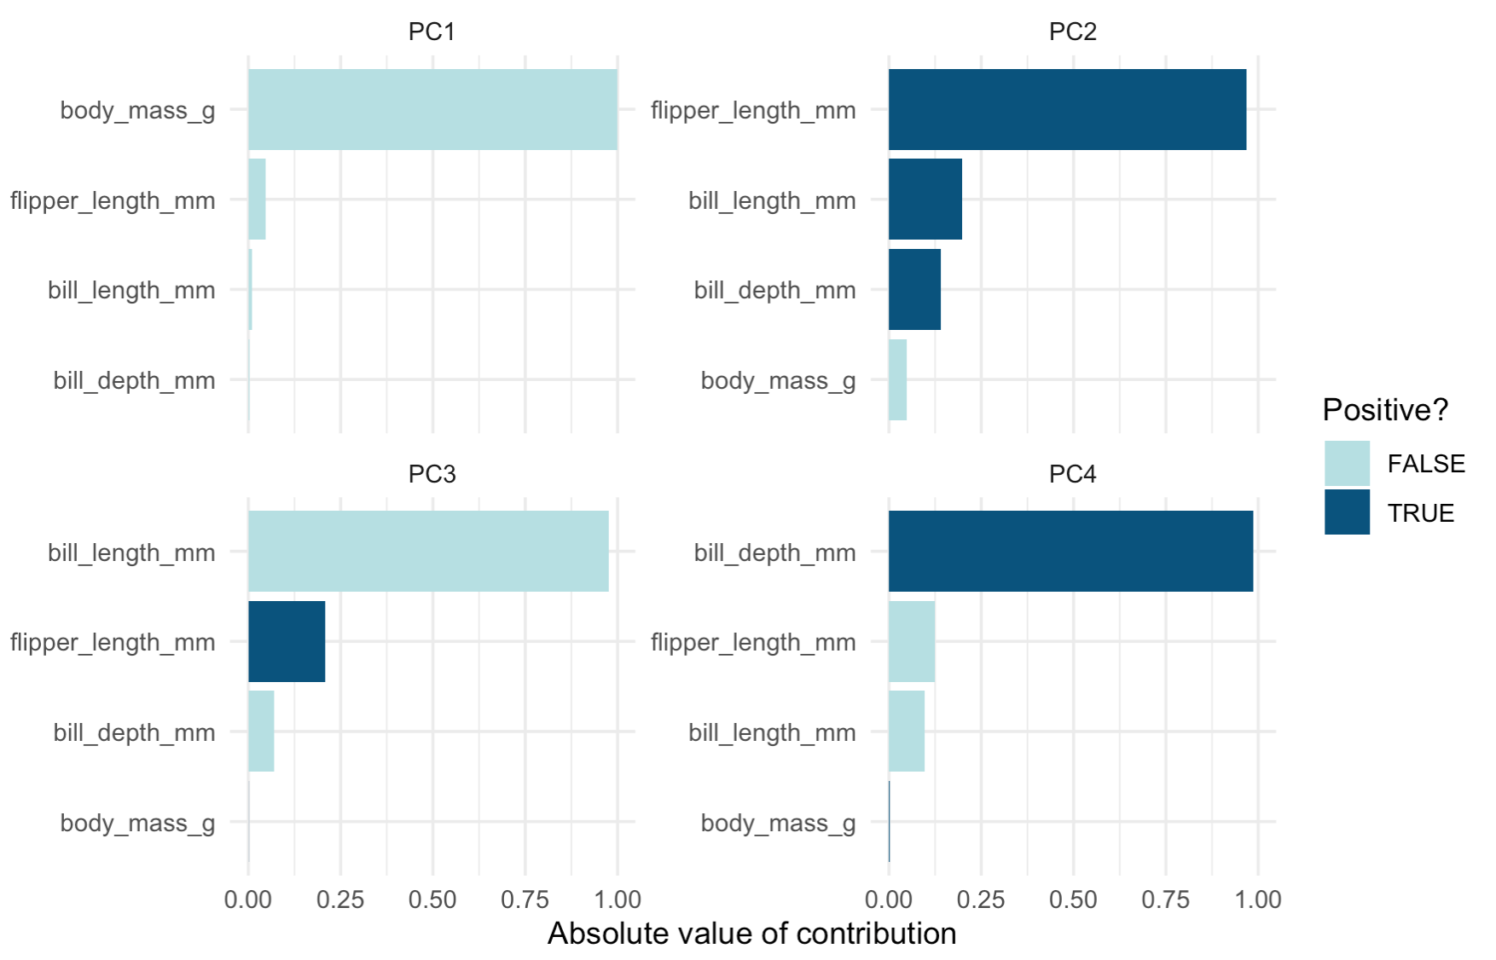
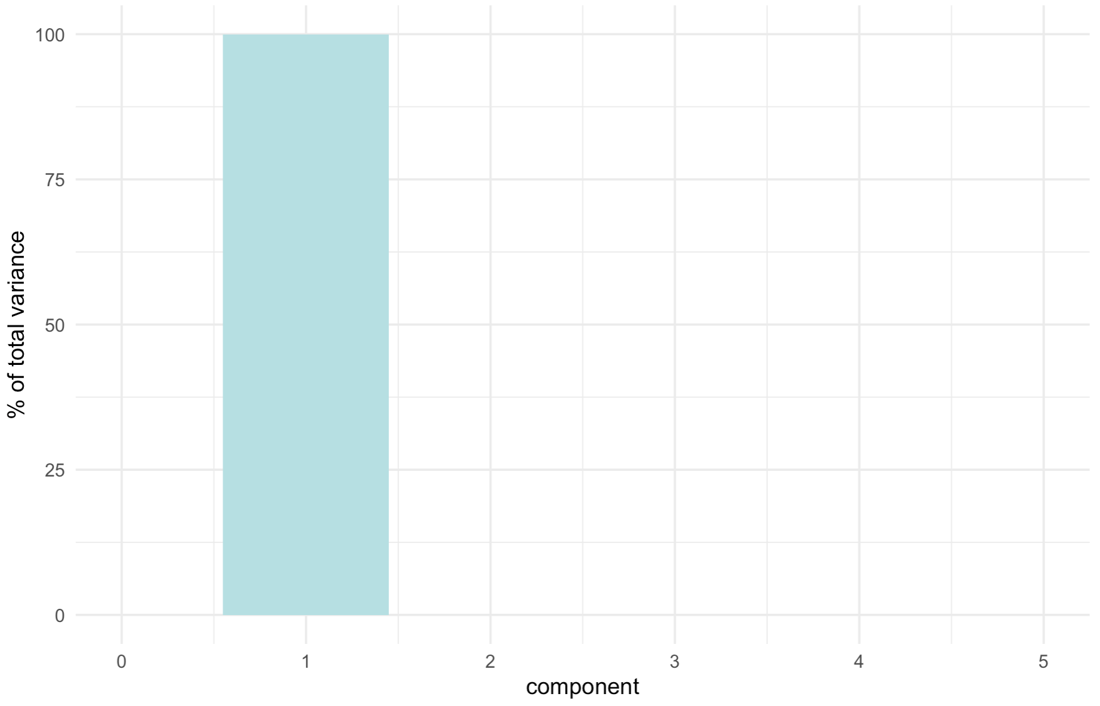
Data pre-processing. Feature engineering Adjusting data without tampering with signal
The PCAs rely on computing eigenvalues and the respective eigenvectors.
The PCs are linear combinations of features.
Not scaling and centering the features only underlines the magnitude of the features.

Slide 20
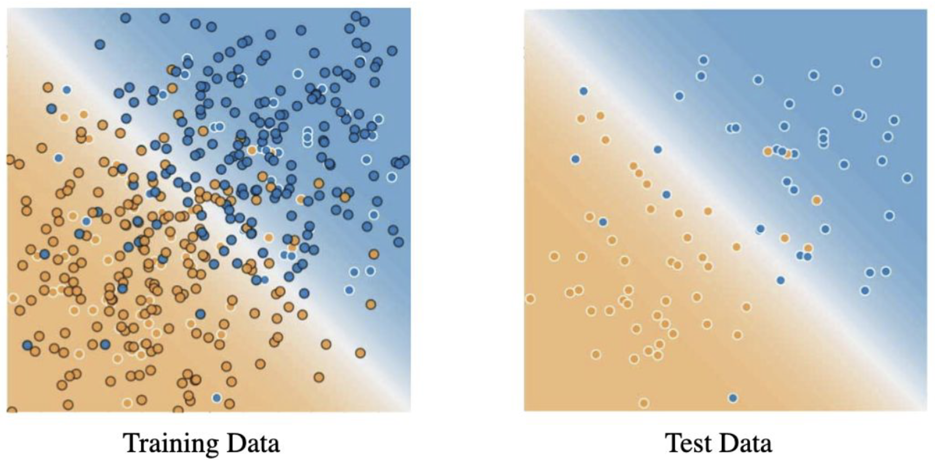
Data pre-processing. Feature engineering Model robustness.
Dataset
Output
How do we ensure the model is reliable/ robust?
Do we have access to independent testing data?
Deterministic/ probabilistic Machine Learning model
Training set
Test set
Proportion of training/ test split
To ensure robustness (and optimize the model) –
we perform this split several times.
The test set should act an independent evaluation of the model

Slide 21
Data pre-processing. Feature engineering Model robustness.
Training set
Test set
Assumptions for the training/ validation/ test sets
[a] we draw the samples independently and identically (iid) at random from the distribution
[b] the sets are disjunct partitions of the original distribution
i.e. no entries from the the training set will be found in the test set and vice versa
[c] the size of the validation and test sets should be comparable (if not identical)
The validation set should be large enough to detect differences between models
If classifier A has an accuracy of 95% and classifier B has an accuracy 95.1% then a validation set of 100
entries would not be sufficient/ able to detect the 0.1% difference.
A validation set with 1000 – 10000 entries might detect the improvement of 0.1%

Slide 22
Data pre-processing. Feature engineering Model robustness.
Train the model on the
Training set
Evaluate the model on the
Test set
Tweak the model (optimize parameters) based on feedback from the Test set
Select the model that performs best on the Test set
Problem: the evaluation on the test set, after the model was optimized, is no longer unbiased (self-fulfilling prophecy).

Slide 23
Data pre-processing. Feature engineering Model robustness.
Training set
Test set
Assumptions for the training/ validation/ test sets
[d] on the test set, the error between the prediction and the actual label is the test error
[e] the objective function of the algorithm minimizes the test errors by parameter tuning
[f] Models are further evaluated for Bias and Variance (assessment of overfitting/ underfitting)

Slide 24
Data pre-processing. Feature engineering Model robustness.
Training set
Test set
Training set
Test set
Validate set
Train the model on the
Training set
Evaluate the model on the
Validation set
Tweak the model (optimize parameters) based on feedback from the Validation set
Select the model that performs best on the Validation set
Confirm the model on the Test set
Advantage: the test set is uncorrupted and the evaluation is unbiased

Slide 25
Data pre-processing. Feature engineering Cross validation.
Train the model on the
Training set
Evaluate the model on the
Validation set
Tweak the model (optimize parameters) based on feedback from the Validation set
Select the model that performs best on the Validation set
Confirm the model on the Test set
A systematic approach would rely on cross validation.

Slide 26
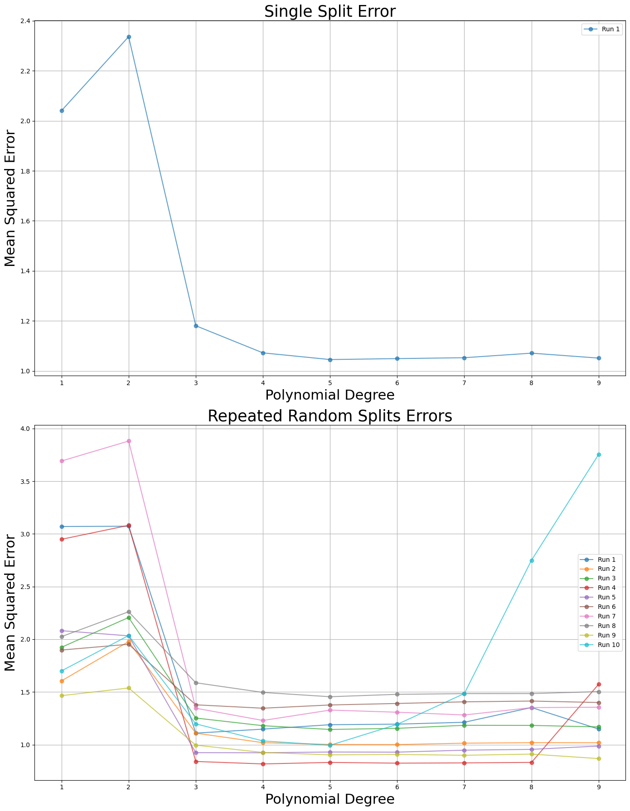
Data pre-processing. Feature engineering Cross validation.
In:
Out:
1, 2, 3, …. n
2, 9, 28, …. n
Task: infer a function that models the output wrt the input.

Slide 27
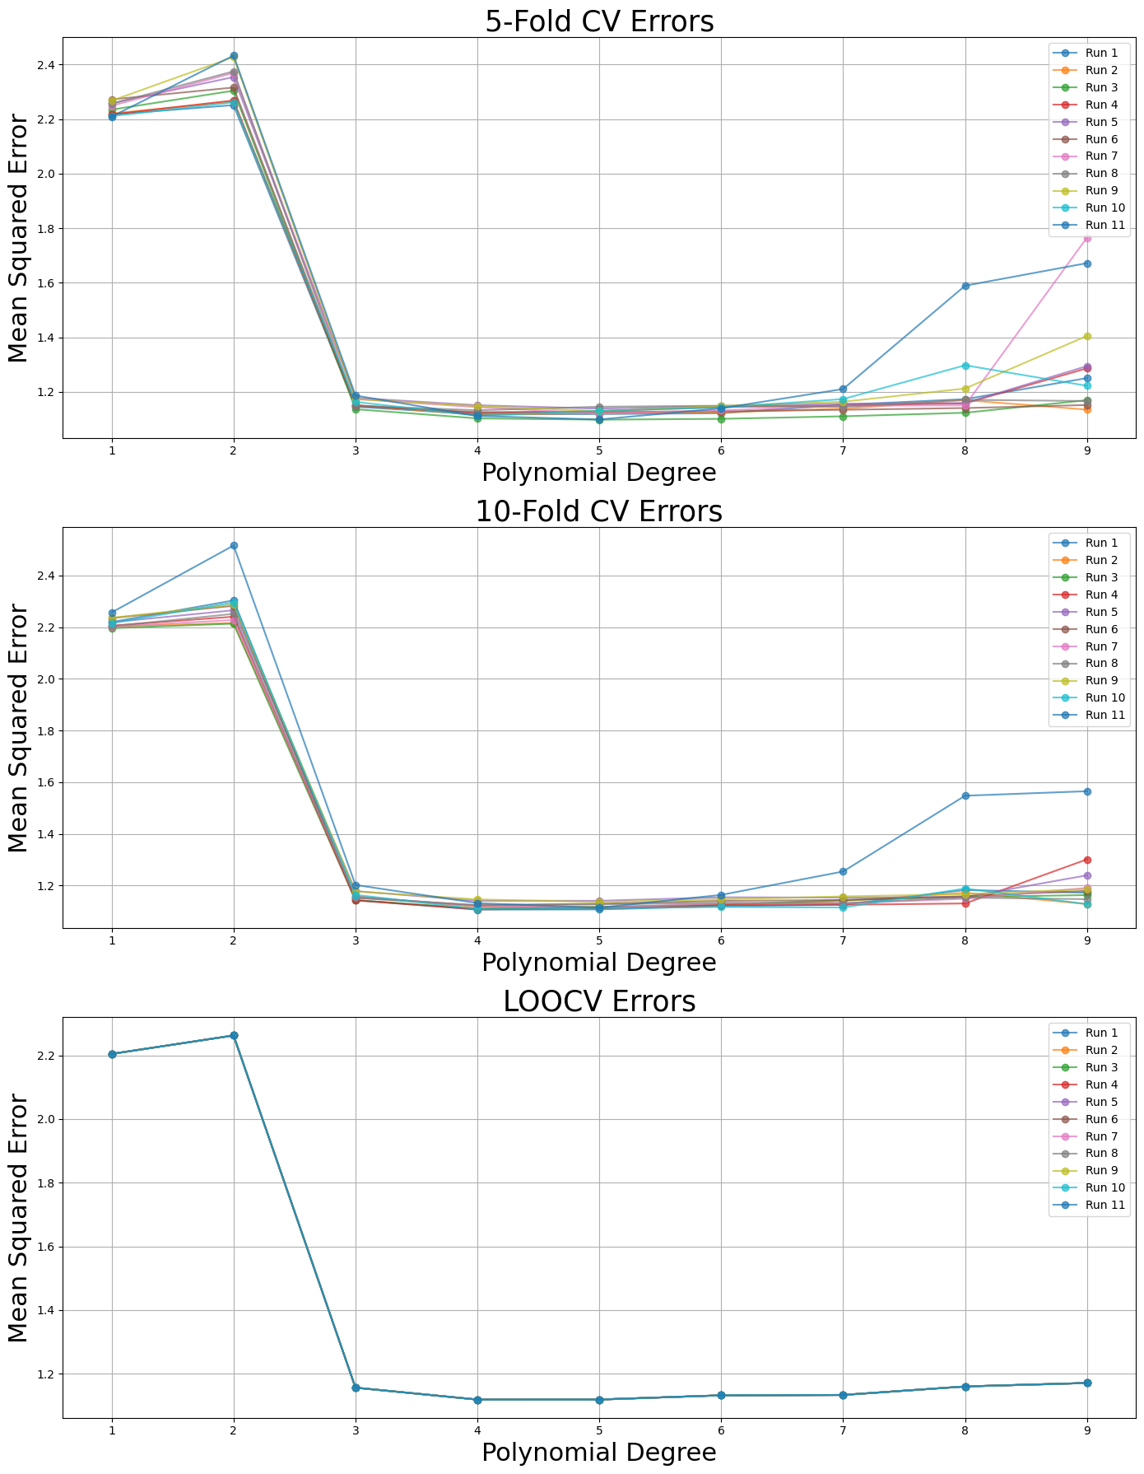
Data pre-processing. Feature engineering Cross validation.
Leave on out CV separates one entry at a time.
In:
Out:
1, 2, 3, …. n
2, 9, 28, …. n
A validation on one entry is meaningless.
The validation set is too small.

Slide 28
Data pre-processing. Feature engineering Cross validation.
In:
Out:
1, 2, 3, …. n
2, 9, 28, …. n

Slide 29
Data pre-processing. Feature engineering Cross validation. Evaluation
 |  | Predicted condition
 | Total population = P + N | Predicted condition positive (PP) | Predicted condition negative (PN)
Actual Condition | Actual condition positive (P) | True positive (TP) | False negative (FN) – Type II error
 | Actual condition negative (N) | False positive (FP) – Type I error | True negative (TN)
Remarks
[a] we don’t always have access to all information
e.g. the true negative set might be unknown
e.g. the false negative set might be unknown
[b] always strive to assess the model from multiple angles
i.e. don’t reply solely on one value such as accuracy.
[c] multiple class classification can be simplified to a 2x2 table

Slide 30
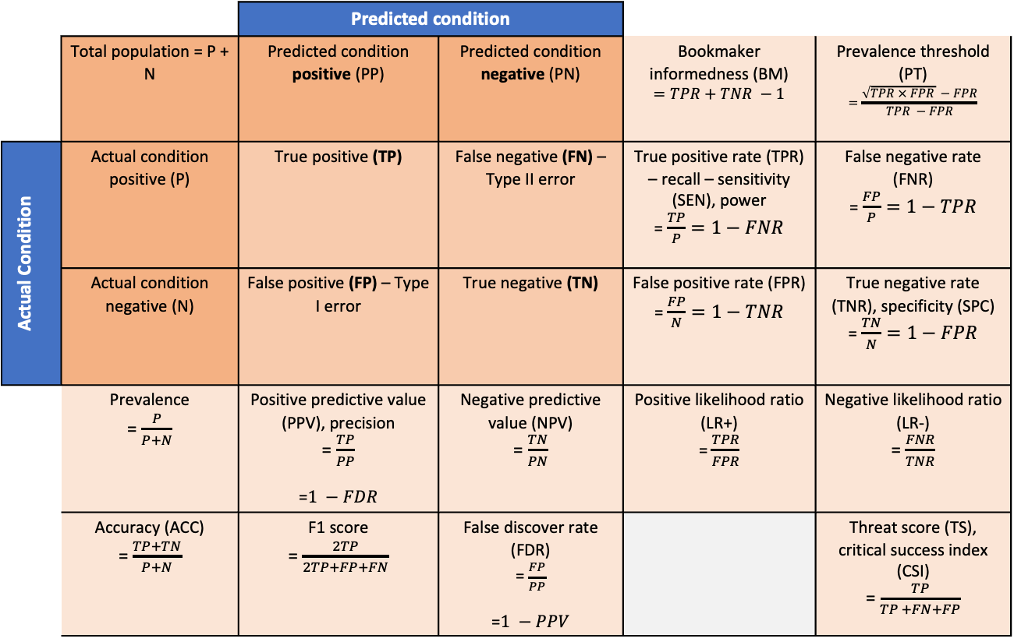
Data pre-processing. Feature engineering Cross validation. Evaluation
 |  | Predicted condition
 | Total population = P + N | Predicted condition positive (PP) | Predicted condition negative (PN) | Bookmaker informedness (BM) $$=TPR+TNR −1$$ | Prevalence threshold (PT) $$=\frac{\sqrt{TPR × FPR} −FPR}{TPR −FPR}$$
Actual Condition | Actual condition positive (P) | True positive (TP) | False negative (FN) – Type II error | True positive rate (TPR) – recall – sensitivity (SEN), power = $\frac{TP}{P}=1−FNR$ | False negative rate (FNR) = $\frac{FP}{P}=1−TPR$
 | Actual condition negative (N) | False positive (FP) – Type I error | True negative (TN) | False positive rate (FPR) = $\frac{FP}{N}=1−TNR$ | True negative rate (TNR), specificity (SPC) = $\frac{TN}{N}=1−FPR$
 | Prevalence = $\frac{P}{P+N}$ | Positive predictive value (PPV), precision = $\frac{TP}{PP}$ =$1 −FDR$ | Negative predictive value (NPV) = $\frac{TN}{PN}$ | Positive likelihood ratio (LR+) = $\frac{TPR}{FPR}$ | Negative likelihood ratio (LR-) = $\frac{FNR}{TNR}$
 | Accuracy (ACC) = $\frac{TP+TN}{P+N}$ | F1 score = $\frac{2TP}{2TP+FP+FN}$ | False discover rate (FDR) = $\frac{FP}{PP}$ =$1 −PPV$ |  | Threat score (TS), critical success index (CSI) = $\frac{TP}{TP +FN+FP}$

Slide 31
Data pre-processing. Feature engineering Cross validation. Evaluation
Training set
Test set
Validate set
Sources of error in ML: bias and variance
Bias: the model’s error rate on the training set
Variance: the model’s error rate on the validation (or test) set, in addition to the bias
Training error: 0.5% [bias]
Validation error: 1% (variance = 0.5%)
Perfect model
Training error: 15% [bias]
Validation error: 16% (variance = 1%)
Underfitting – learning some signal
Training error: 1% [bias]
Validation error: 11% (variance = 10%)
Overfitting – learning signal and noise
Training error: 15% [bias]
Validation error: 30% (variance = 15%)
High bias, high variance
Model unlikely suitable for the data.

Slide 32
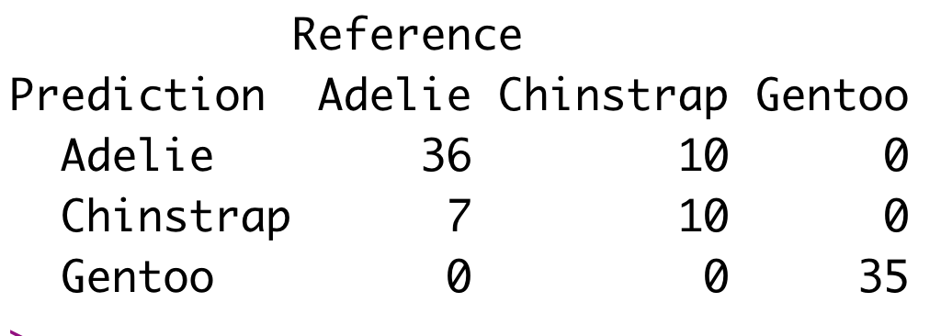
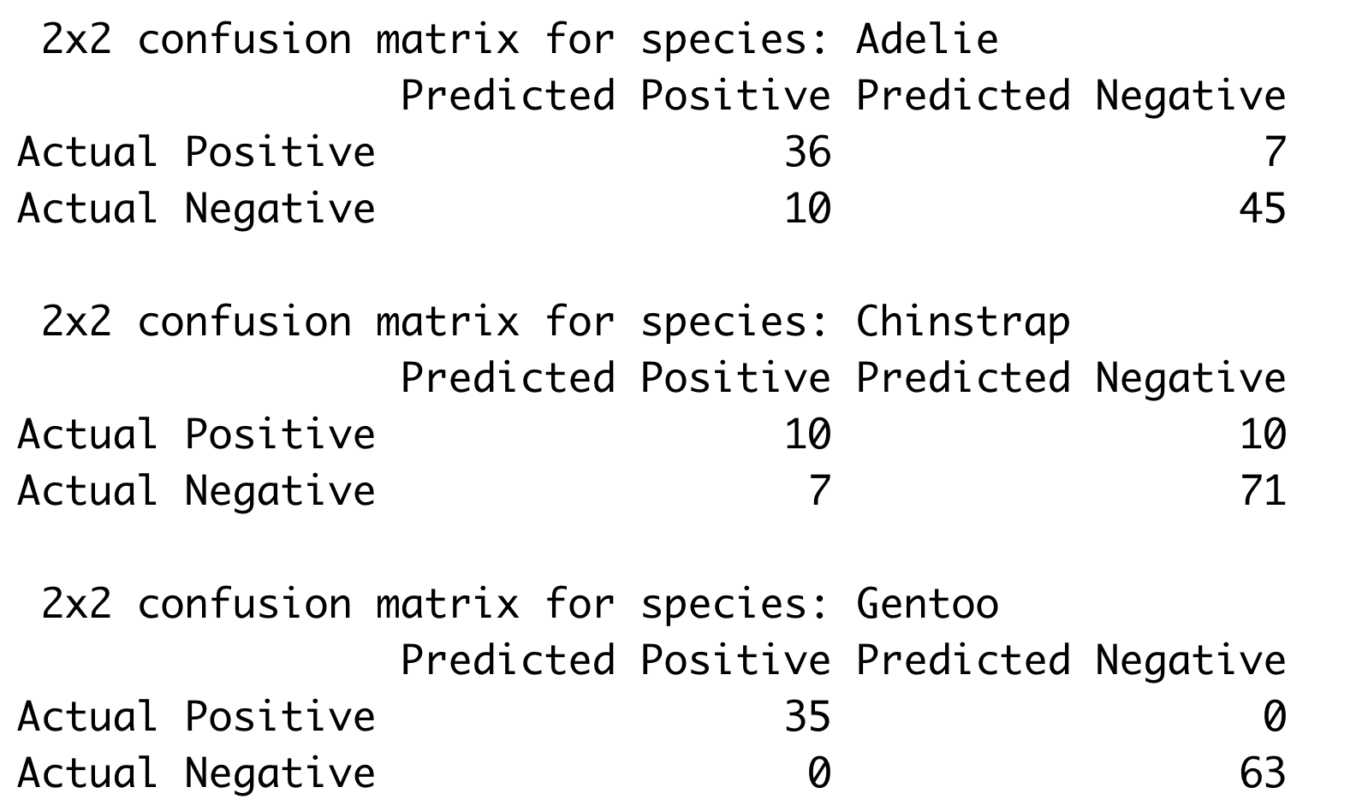
Data pre-processing. Feature engineering Evaluation. Confusion Matrices
A
A
FN
FP
TN

Slide 33
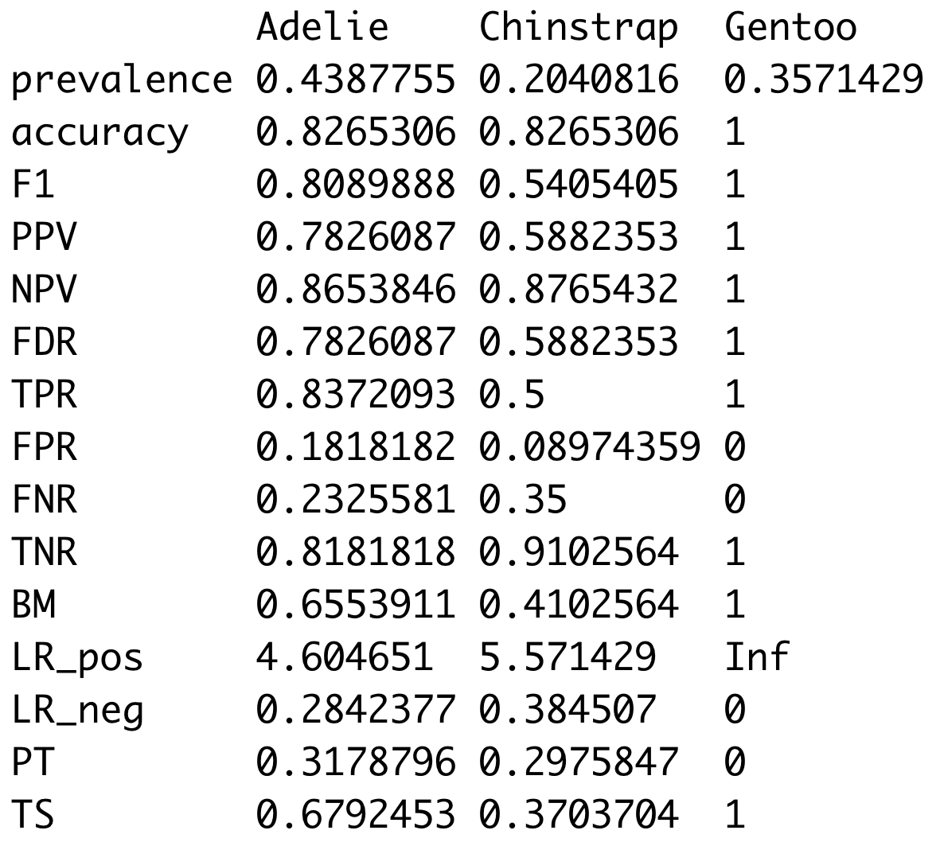
Data pre-processing. Feature engineering Evaluation. Confusion Matrices
Note: check slide 28 for calculations

Slide 34
Statistics for a 2x2 confusion matrix - Adelie
 |  | Predicted condition
 | Total population = P + N | Predicted condition positive (PP) | Predicted condition negative (PN) | Bookmaker informedness (BM) 0.66 | Prevalence threshold (PT) 0.32
Actual Condition | Actual condition positive (P) | True positive (TP) 36 | False negative (FN) – Type II error 7 | True positive rate (TPR) – recall – sensitivity (SEN), power 0.84 | False negative rate (FNR) 0.23
 | Actual condition negative (N) | False positive (FP) – Type I error 10 | True negative (TN) 45 | False positive rate (FPR) 0.18 | True negative rate (TNR), specificity (SPC) 0.82
 | Prevalence 0.43 | Positive predictive value (PPV), precision 0.78 | Negative predictive value (NPV) 0.87 | Positive likelihood ratio (LR+) 4.6 | Negative likelihood ratio (LR-) 0.28
 | Accuracy (ACC) 0.83 | F1 score 0.81 | False discover rate (FDR) 0.21 |  | Threat score (TS), critical success index (CSI) 0.68

Slide 35
Data pre-processing. Unbalanced data. Sampling?
It can be a struggle to gather enough balanced data for a machine learning project.
Examples of issues:
Negative examples are easier to sample than positive ones.
e.g. negative examples of galaxies outweigh the number of positive/ confirmed examples
Another angle: not all galaxies that exist were identified [we don’t know what we don’t]
The intrinsic structure of the data confounds classes
e.g. on classes A, B, C driven by the features of the data,
Class A comprises only positive examples, Class B comprises a 20/80 mix, Class C comprises a 50/50 mix
Down sampling = extracting a number of entries from the larger class
Up weighting = adding weights to entries, essentially repeating them.
Issues:
The resulting dataset must recapitulate the properties of the original dataset. [Invariance requirement]
In particular cases, a middle ground between down sampling and up weighting works better.

Slide 36
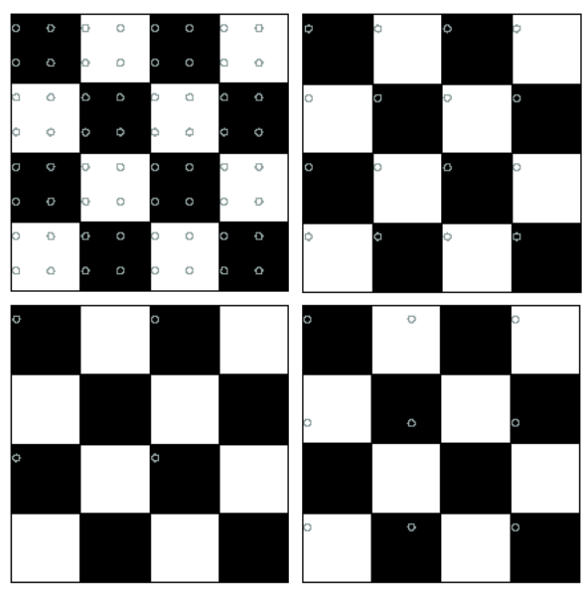
Data pre-processing. Unbalanced data. Sampling?
The Nyquist–Shannon sampling theorem is an essential principle for digital signal processing linking the frequency range of a signal and the sample rate required to avoid a type of distortion called aliasing.
The theorem states that the sample rate must be at least twice the bandwidth of the signal to avoid aliasing distortion.
In practice, it is used to select band-limiting filters to keep aliasing distortion below an acceptable amount when an analog signal is sampled or when sample rates are changed within a digital signal processing function.
Good sampling
Bad sampling
i.e. non representative
For generic distributions, test such as the Kullback-Leiber divergence (per classes or using a binning approach for continuous data) are frequently used.

Slide 37
Next Lecture …
Applied Data Science L3. Data Science toolkit. Part 1

